Slide 1
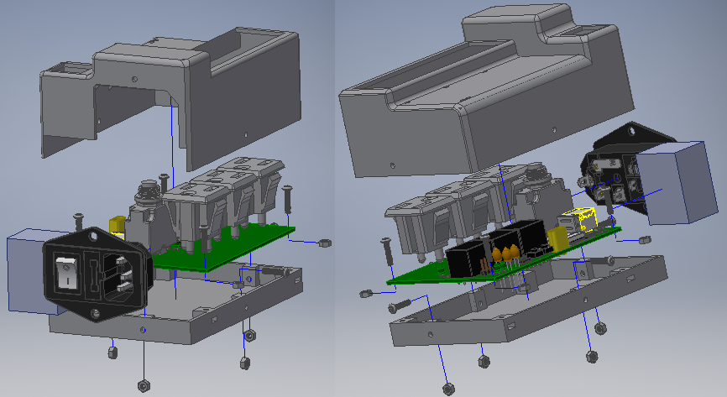
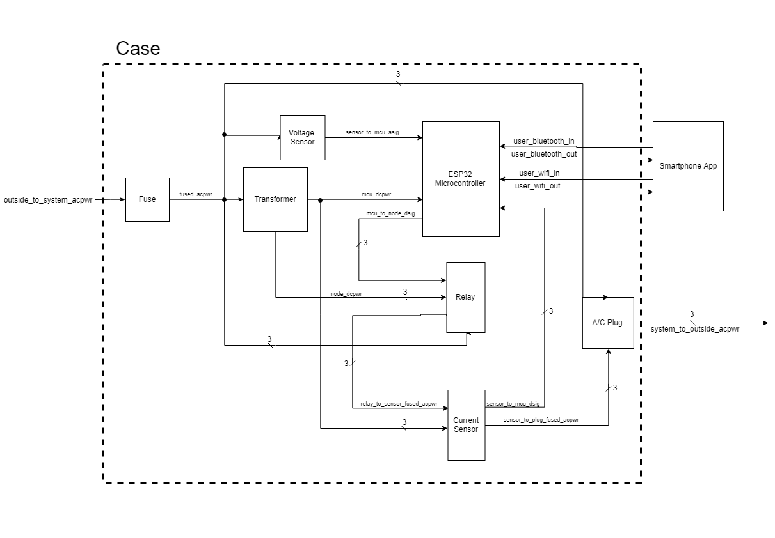
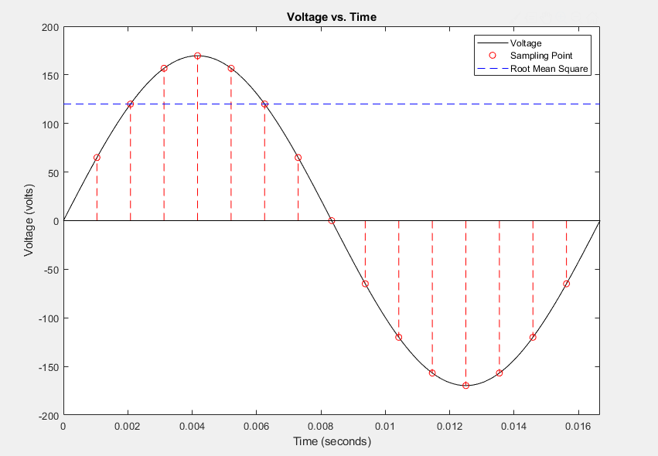
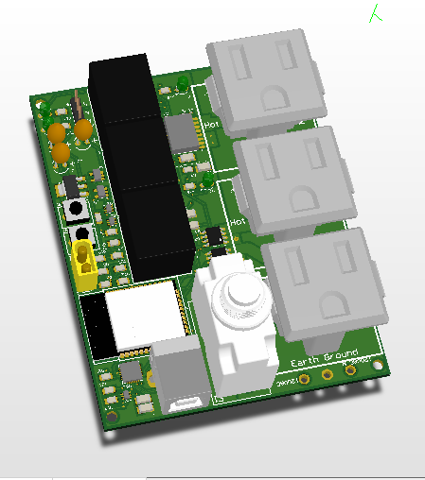
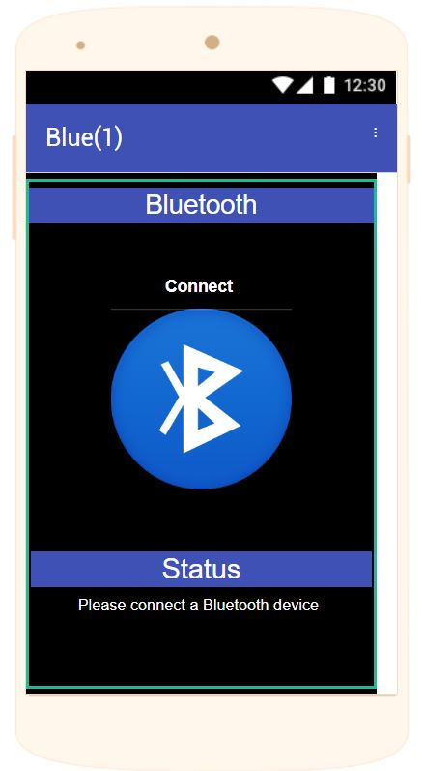
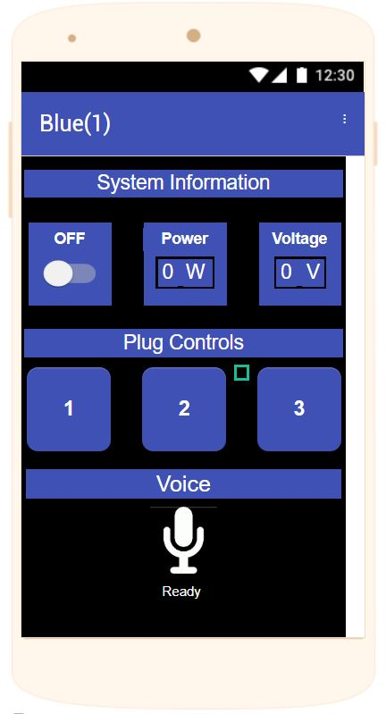
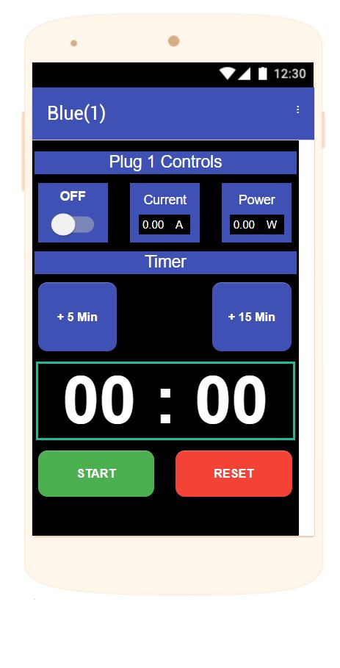
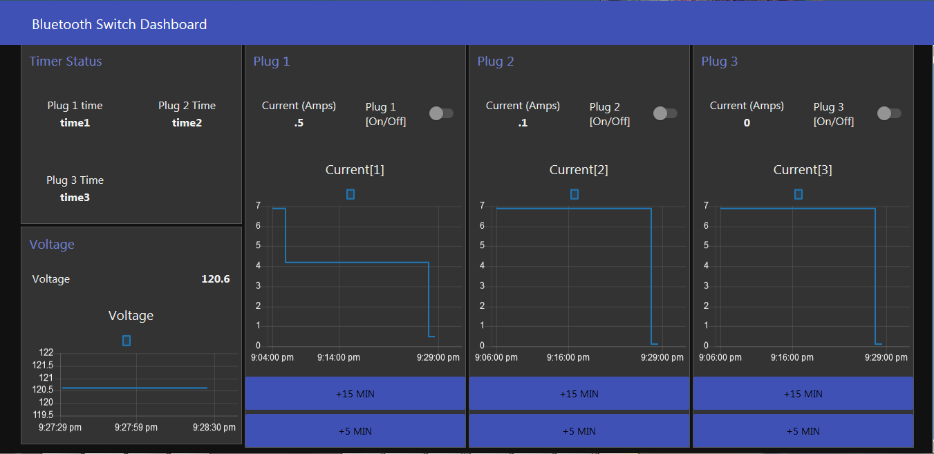
GROUP: 1
Development
Remote AC Smart Switch
ABOUT THE TEAM
Designed and constructed a "smart" plug which enabled user to remotely turn an outlet on or off
Interacts with user via a custom Android/iOS/ smartphone app, over a Bluetooth or WiFi signal
Utilized a custom PCB with a fully integrated ESP32 microcontroller
Capable of handling up to 600W of continuous power delivery
Featured voice command capabilities enabled through Google Voice Interaction API
Intra-board communication enabled through I²C serial protocol
Schematics and PCB created and verified in CircuitMaker
ESP32 microcontroller programmed via Arduino IDE in C++
Improvements
This project employs a very new voltage/current sensing chip: the ACS71020. This chip allows for RMS voltage/current measurements and communication through the I2C protocol. However, being so new, there was no other documented applications other than the datasheet which made integration difficult.
Group Photo
Wirelessly controllable AC power strip with built in monitoring for current, voltage and power.
The system makes use of the powerful ESP32 microcontroller. This System-On-Chip (SOC) has its own integrated Wifi and Bluetooth stack along with a PCB RF antenna which can achieve power of 20dBm. The controller also has an integrated 12bit SAR ADC, I2C serial configuration, and 20 GPIO pins. This flexibility allows it to be an all-in-one package that controls all aspects of the product.
Jorian Bruslind
PCB Layout and Mechanical Design
bruslinj@oregonstate.edu
Mack Hall
Firmware and Sensor Development
hallmac@oregonstate.edu
Zach Bendt
Smartphone App Development
bendtz@oregonstate.edu
More info found here: bit.ly/ACSmartSwitch
The ESP32 microcontroller makes use of multiple sensors to attain accurate voltage and current readings within the system. The sensor can effectively deliver nearly 400 unique current and voltage readings every second within our system, over our serial communication protocol. Using these measurements from the sensors, our microcontroller then calculates the root mean square (RMS) of the data set for the last fraction of a second, which is then interpreted and scaled to deliver a readable, meaningful number to the user.
BASE ENGINEERING REQUIREMENTS
The system will turn off and on at least 2 independent household lamps with up to 100W incandescent bulbs and report current watts delivered by each channel.
9 out of 10 users will be able to turn the switches off and on from a mobile phone in less than 10 seconds without any training or having previously seen the interface.
The system will use only US standard plugins for connecting to external devices and will not allow any object with a diameter greater than 1mm to enter the enclosure, and will be disable if more than 5A is drawn from the wall power.
The system must turn off the output after a time of upto 1 hour ± 1 minute when enabled.
The system will be able to accept commands from a mobile phone over 20 feet away from the plugins.
Furthermore, our fuse was originally intended to be resettable, but proved ineffective at providing protection during a real-world overcurrent situation. A future revision could potentially solve this issue with a more advanced resettable fuse. Finally, the case could undergo further revision to suit future user’s needs better.
Connectivity
The smart switch can be controlled by our smartphone app via bluetooth, as well by a Graphic User Interface (GUI) that is accessible via a web browser. Both have the same features that include:
Turn all channels ON/OFF.
Turn single channel ON/OFF.
Timer that waits up to 1 hour and then turns off individual plug.
Current and power monitoring for each channel.
System voltage monitoring
The App
The Web GUI
UNIQUE ENGINEERING REQUIREMENTS
The system will have WiFi capabilities 10m or more away from a standard household router and will have a web interface that is accessible from a laptop/browser.
The system must be able to accept voice commands through a mobile phone using the Google Now API for all functionality.

